Slide 1
Mathematical Morphology: Open and Close Operations
Computational Geometry
Final Project Presentation
Jenifer Cochran

Slide 2
Outline
Open Method
Close Method
Dilation
Erosion
Future Work
Demonstration

Slide 3
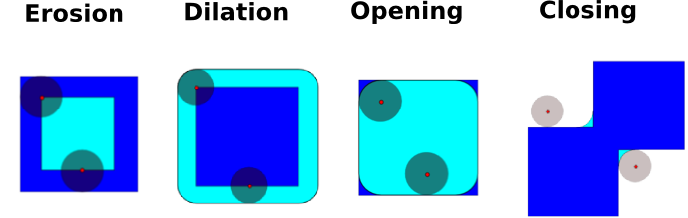

Open Method
The opening of A by B is obtained by the erosion of A by B, followed by dilation of the resulting image by B:
$(A⊝B)⨁B$

Slide 4

Close Method
The closing of A by B is obtained by the dilation of A by B, followed by erosion of the resulting image by B:
$(A⨁B)⊝B$

Slide 5
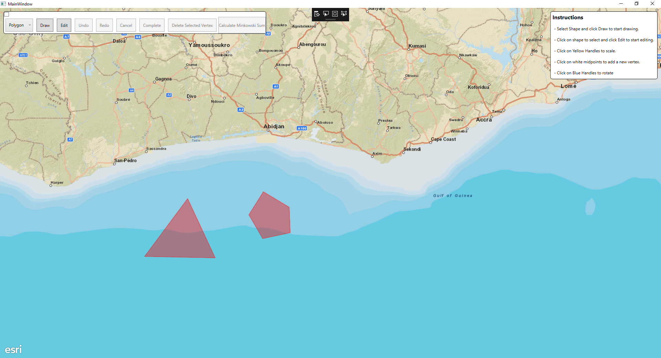
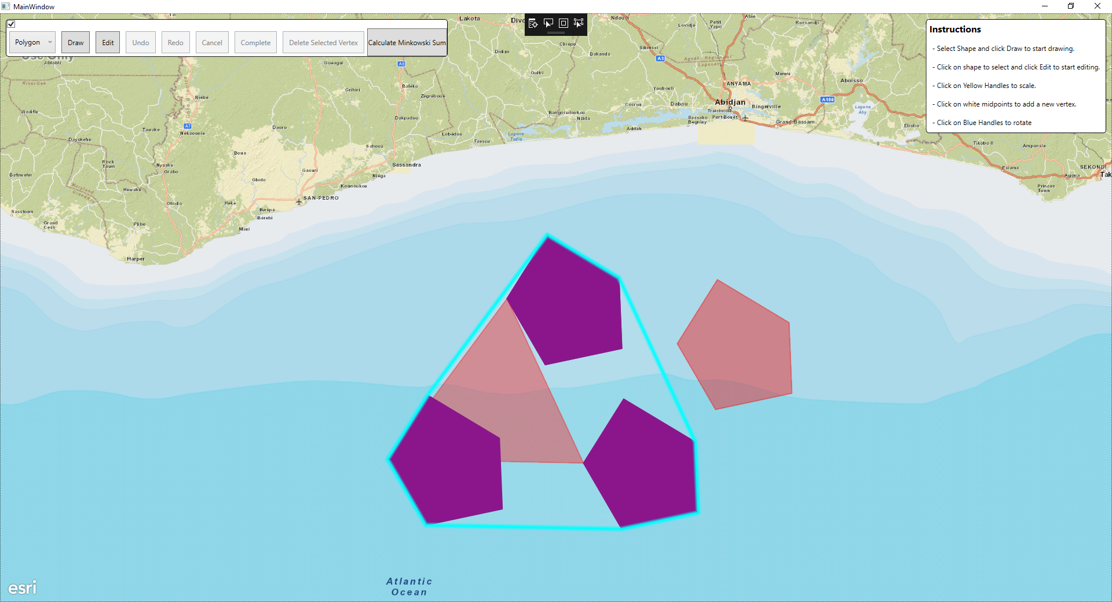

Dilation $(A⨁B)$
The same as Minkowski Sum
First Approach
Take a corner from second polygon and line it up on each vertex for the first polygon
Take the convex hull of all the points

Slide 6
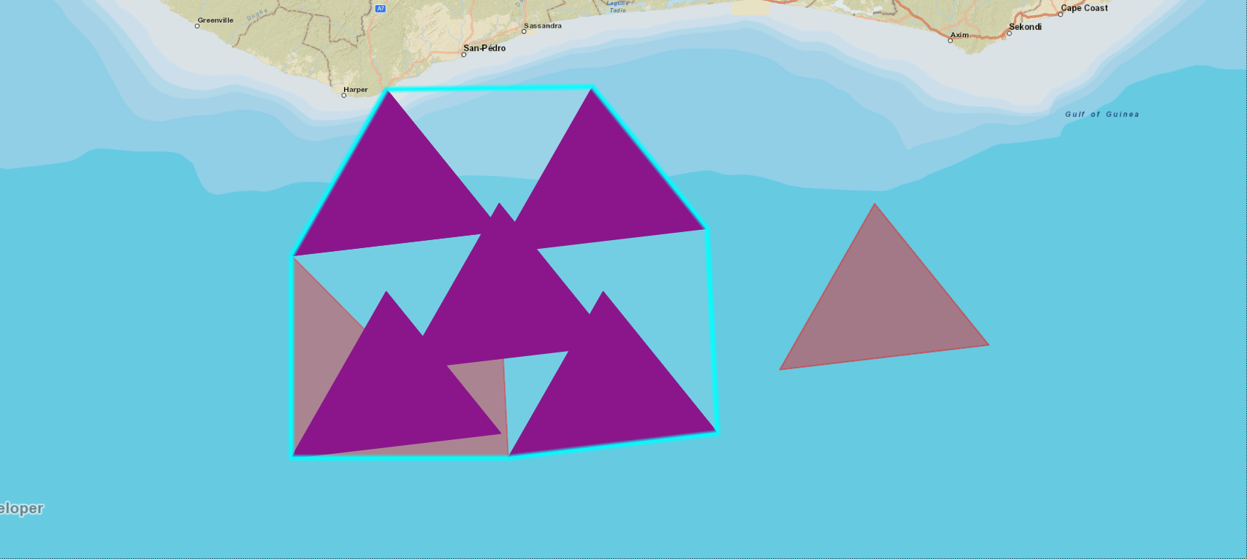
Problems with First Approach…
Only works for convex polygons

Slide 7
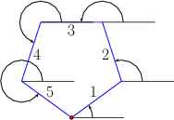
Second Approach: Convolution
For each vertex in Polygon A and Polygon B calculate the angle range
For each vertex in Polygon A find the segments in B that are within the angle range and add that vertex to the segment’s start and end point
For each vertex in Polygon B find the segments in Polygon A that are within the angle range and add that vertex to the segment’s start and end point
The resulting polygon then needs to be simplified (more on how later!)

Slide 8
Convolution

Slide 9
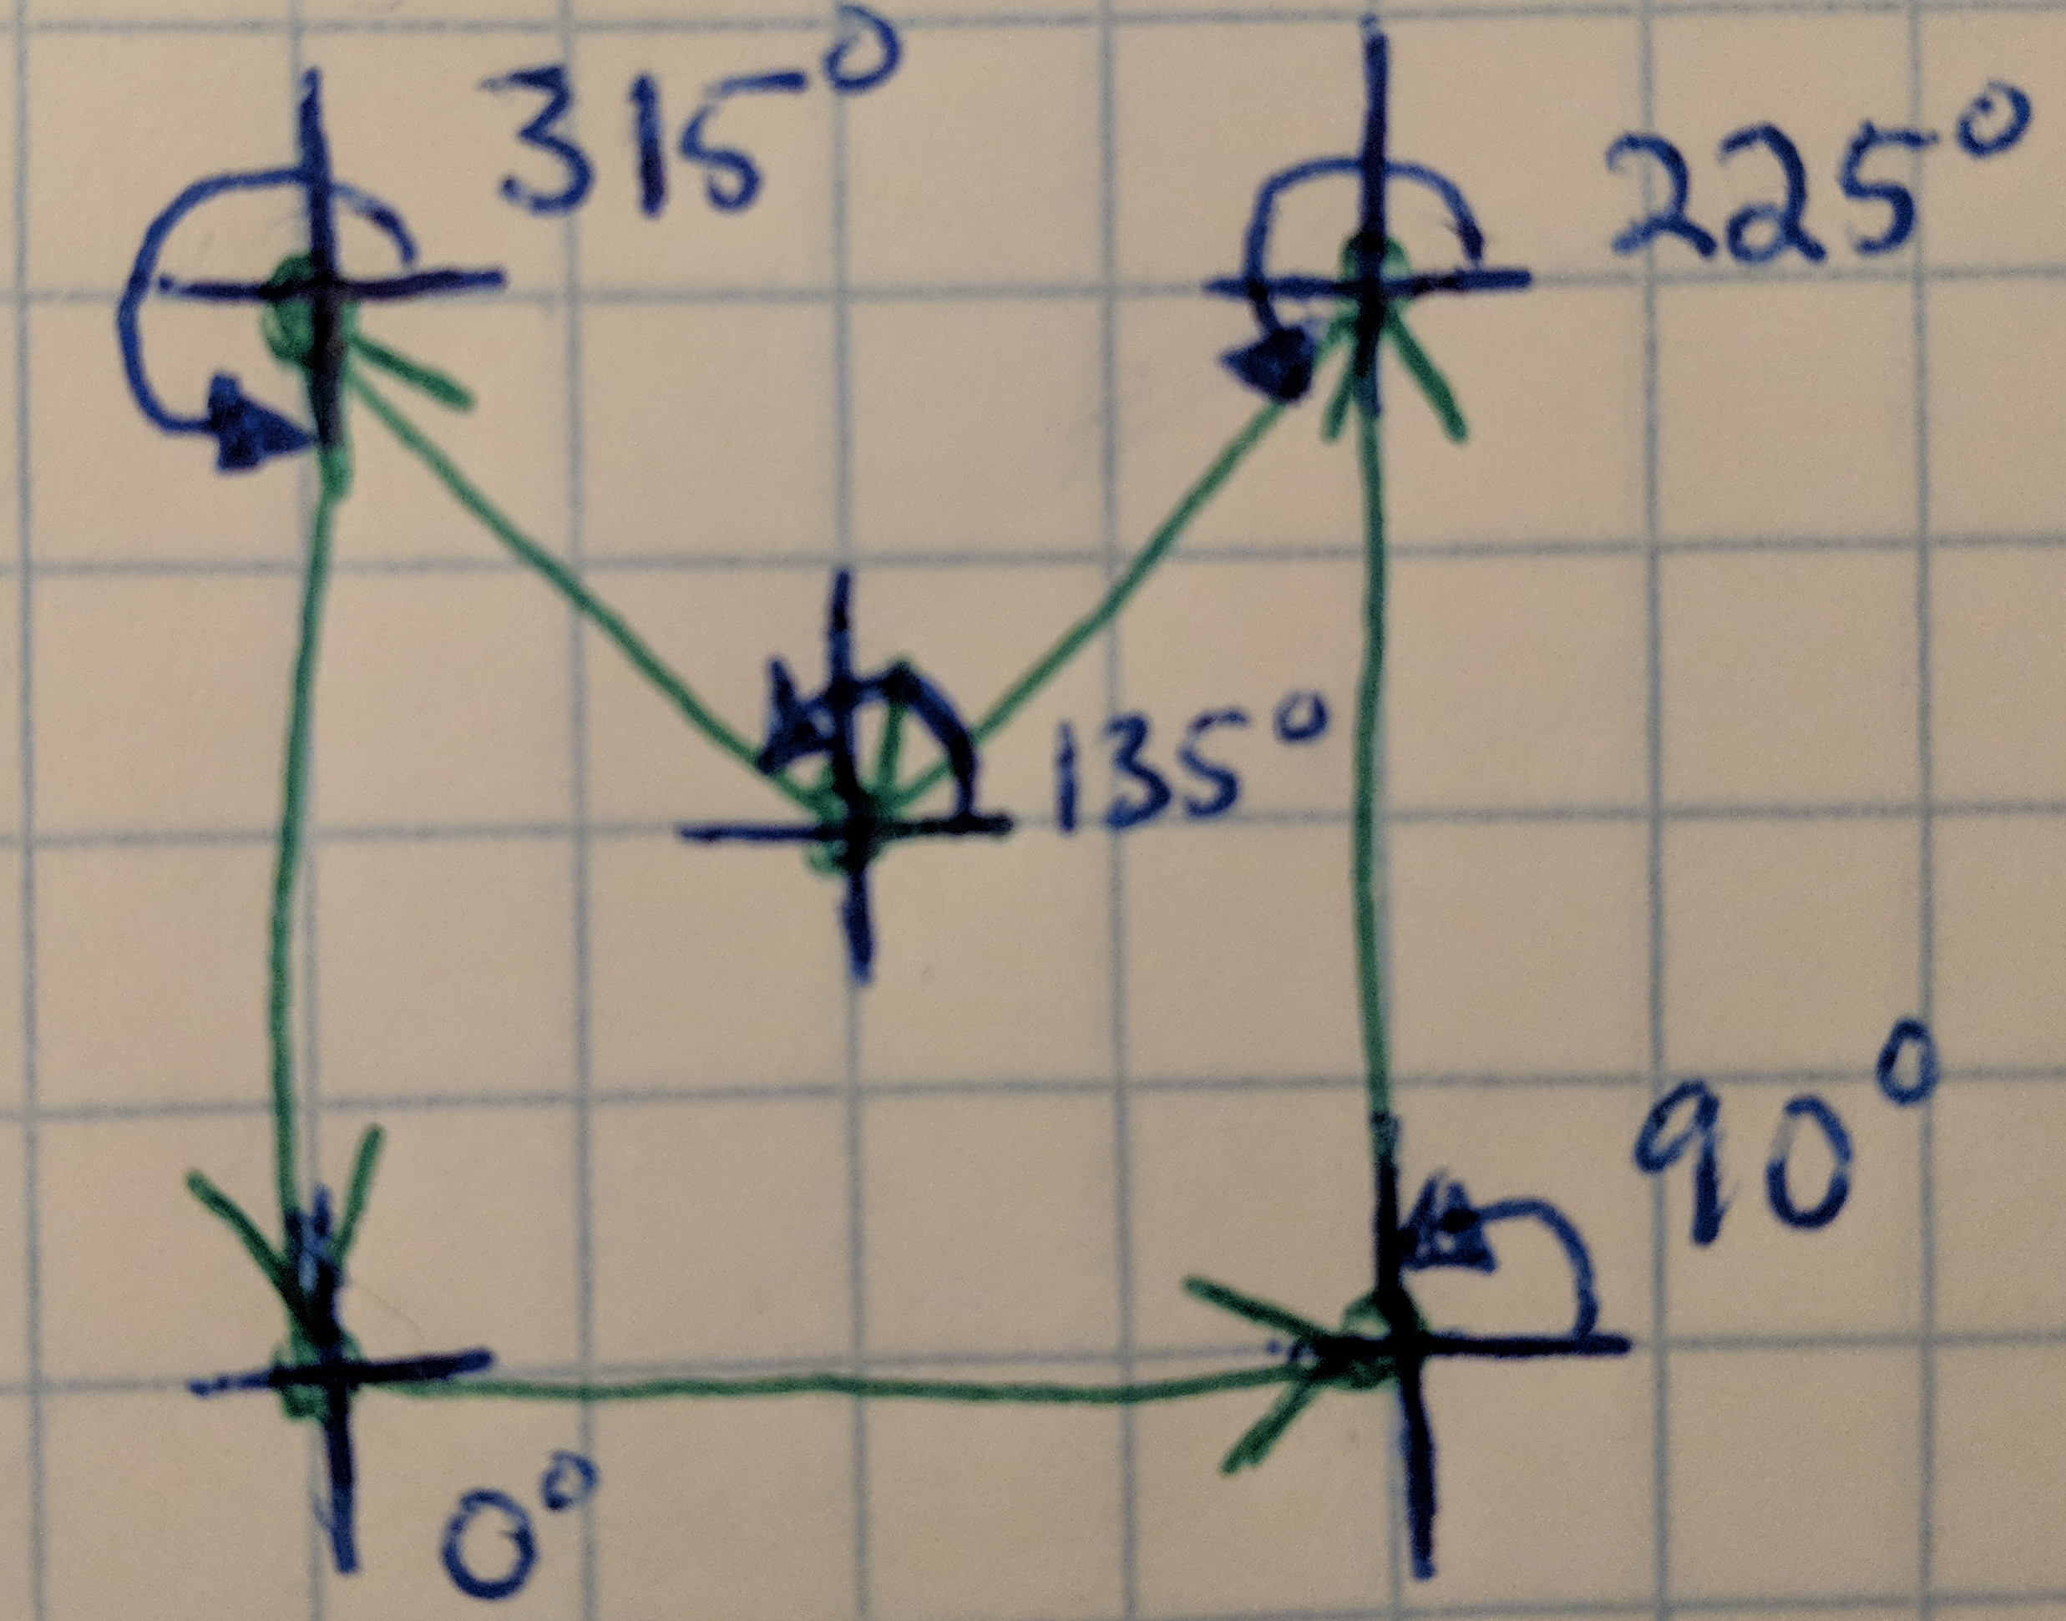
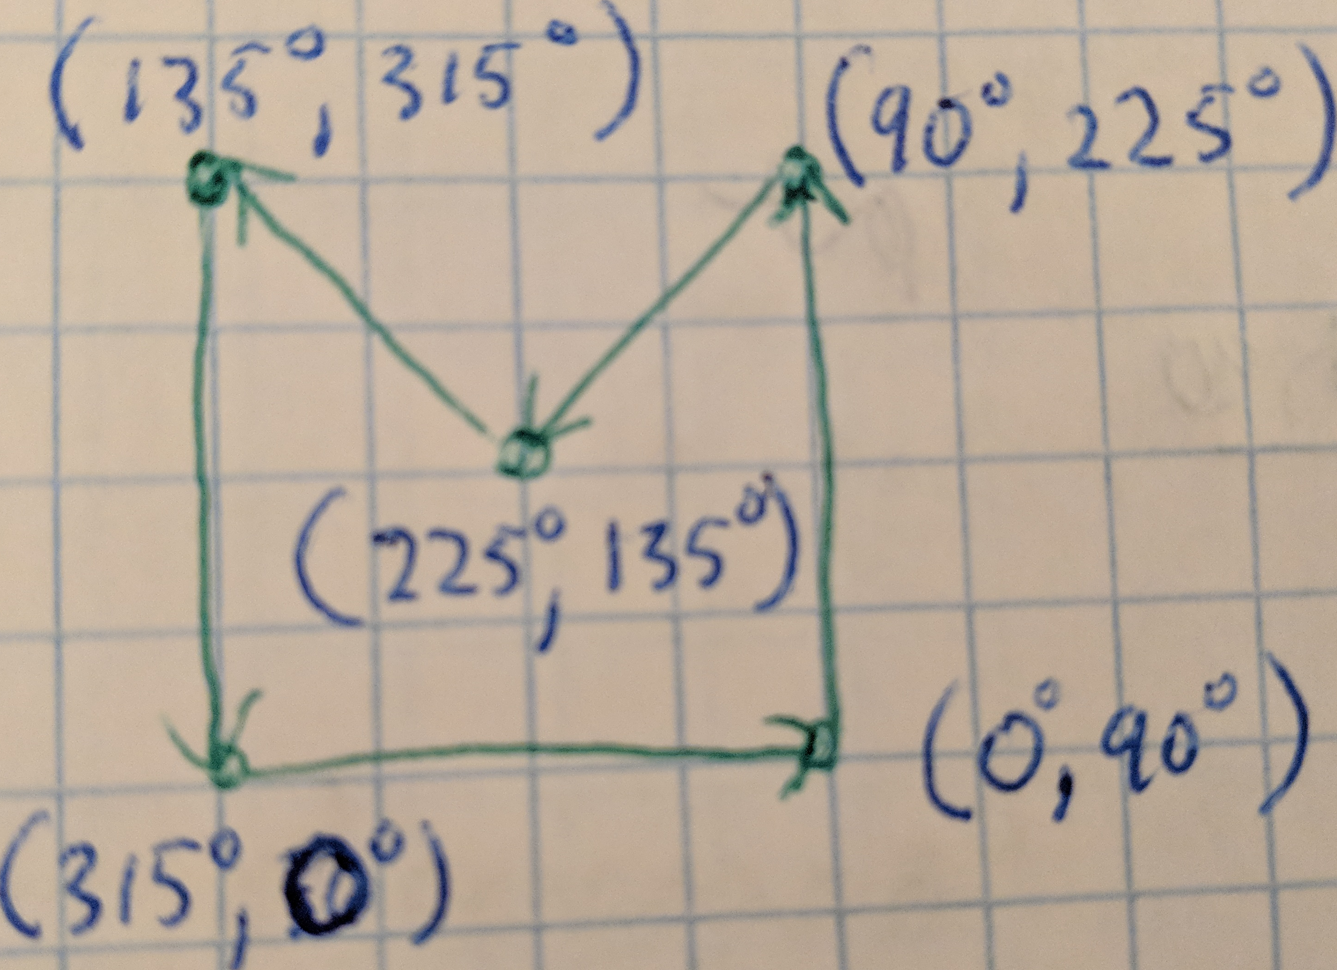
Range Calculation
Calculate the angle at each vertex
Calculate the angle range at each vertex

Slide 10
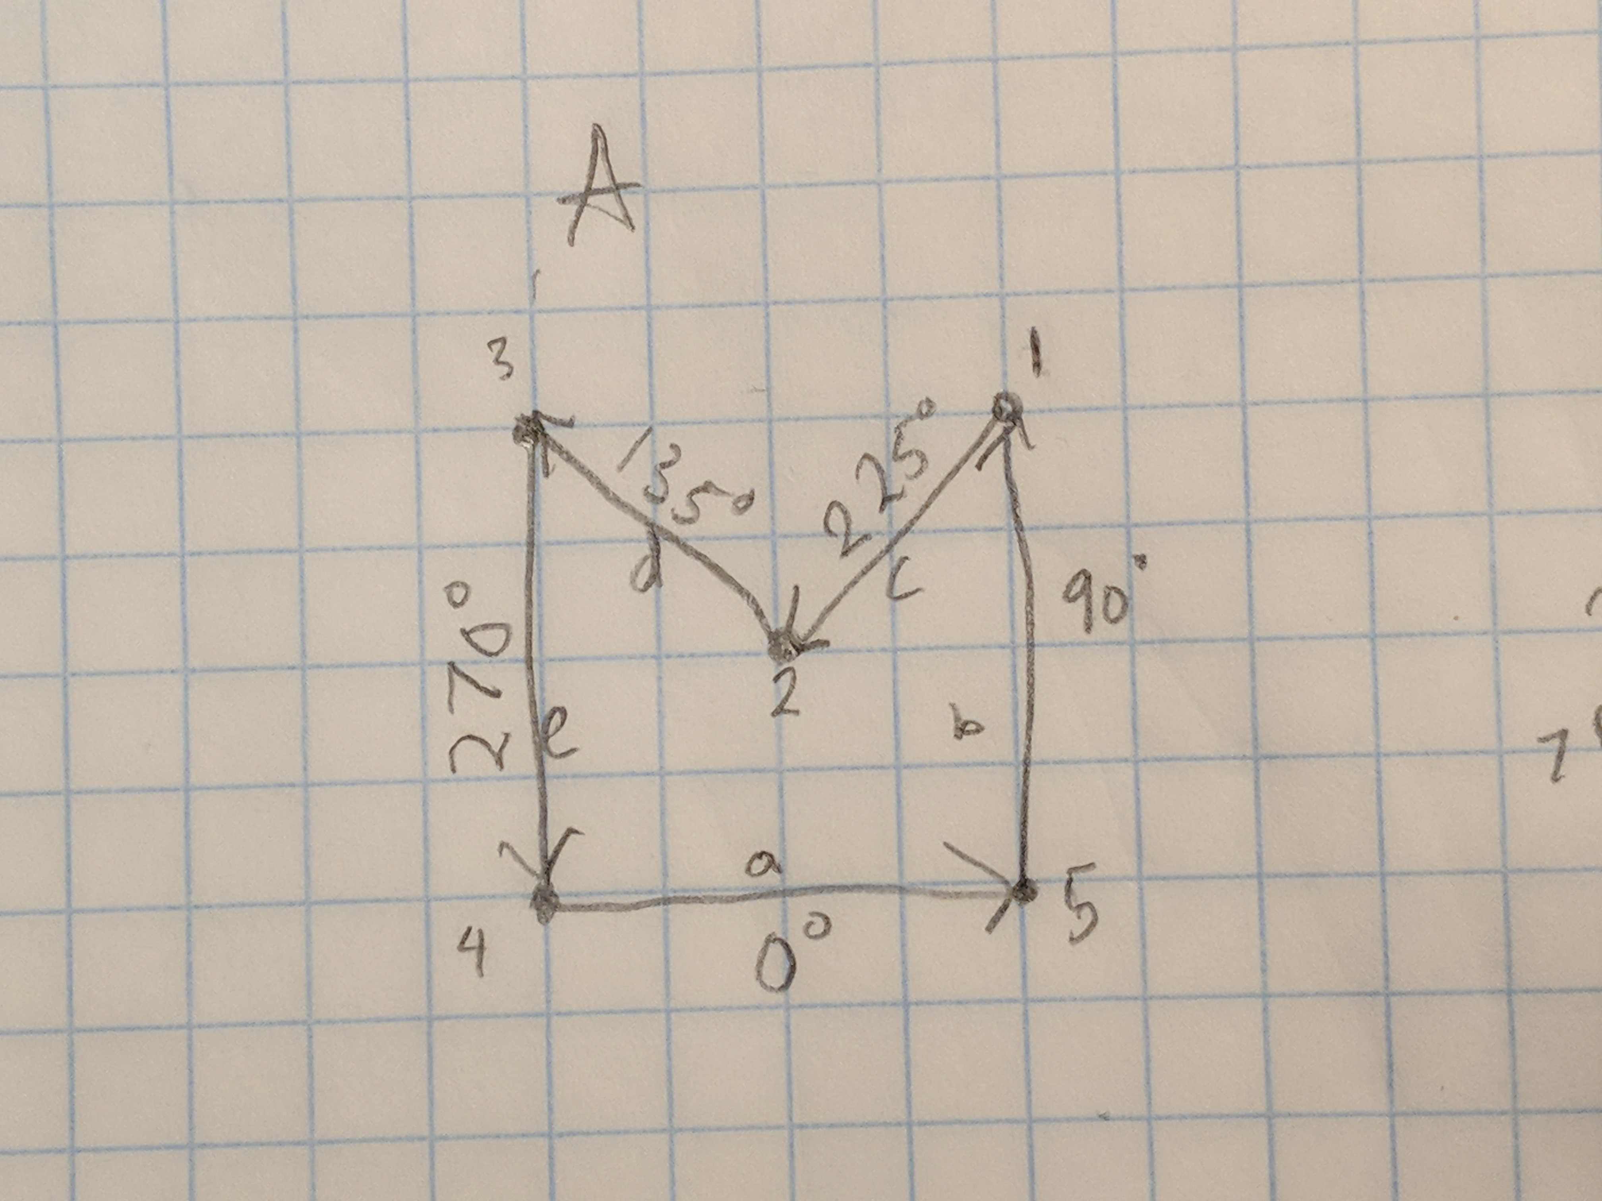
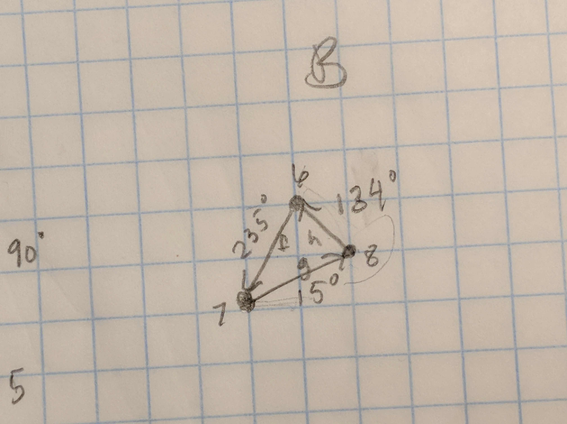
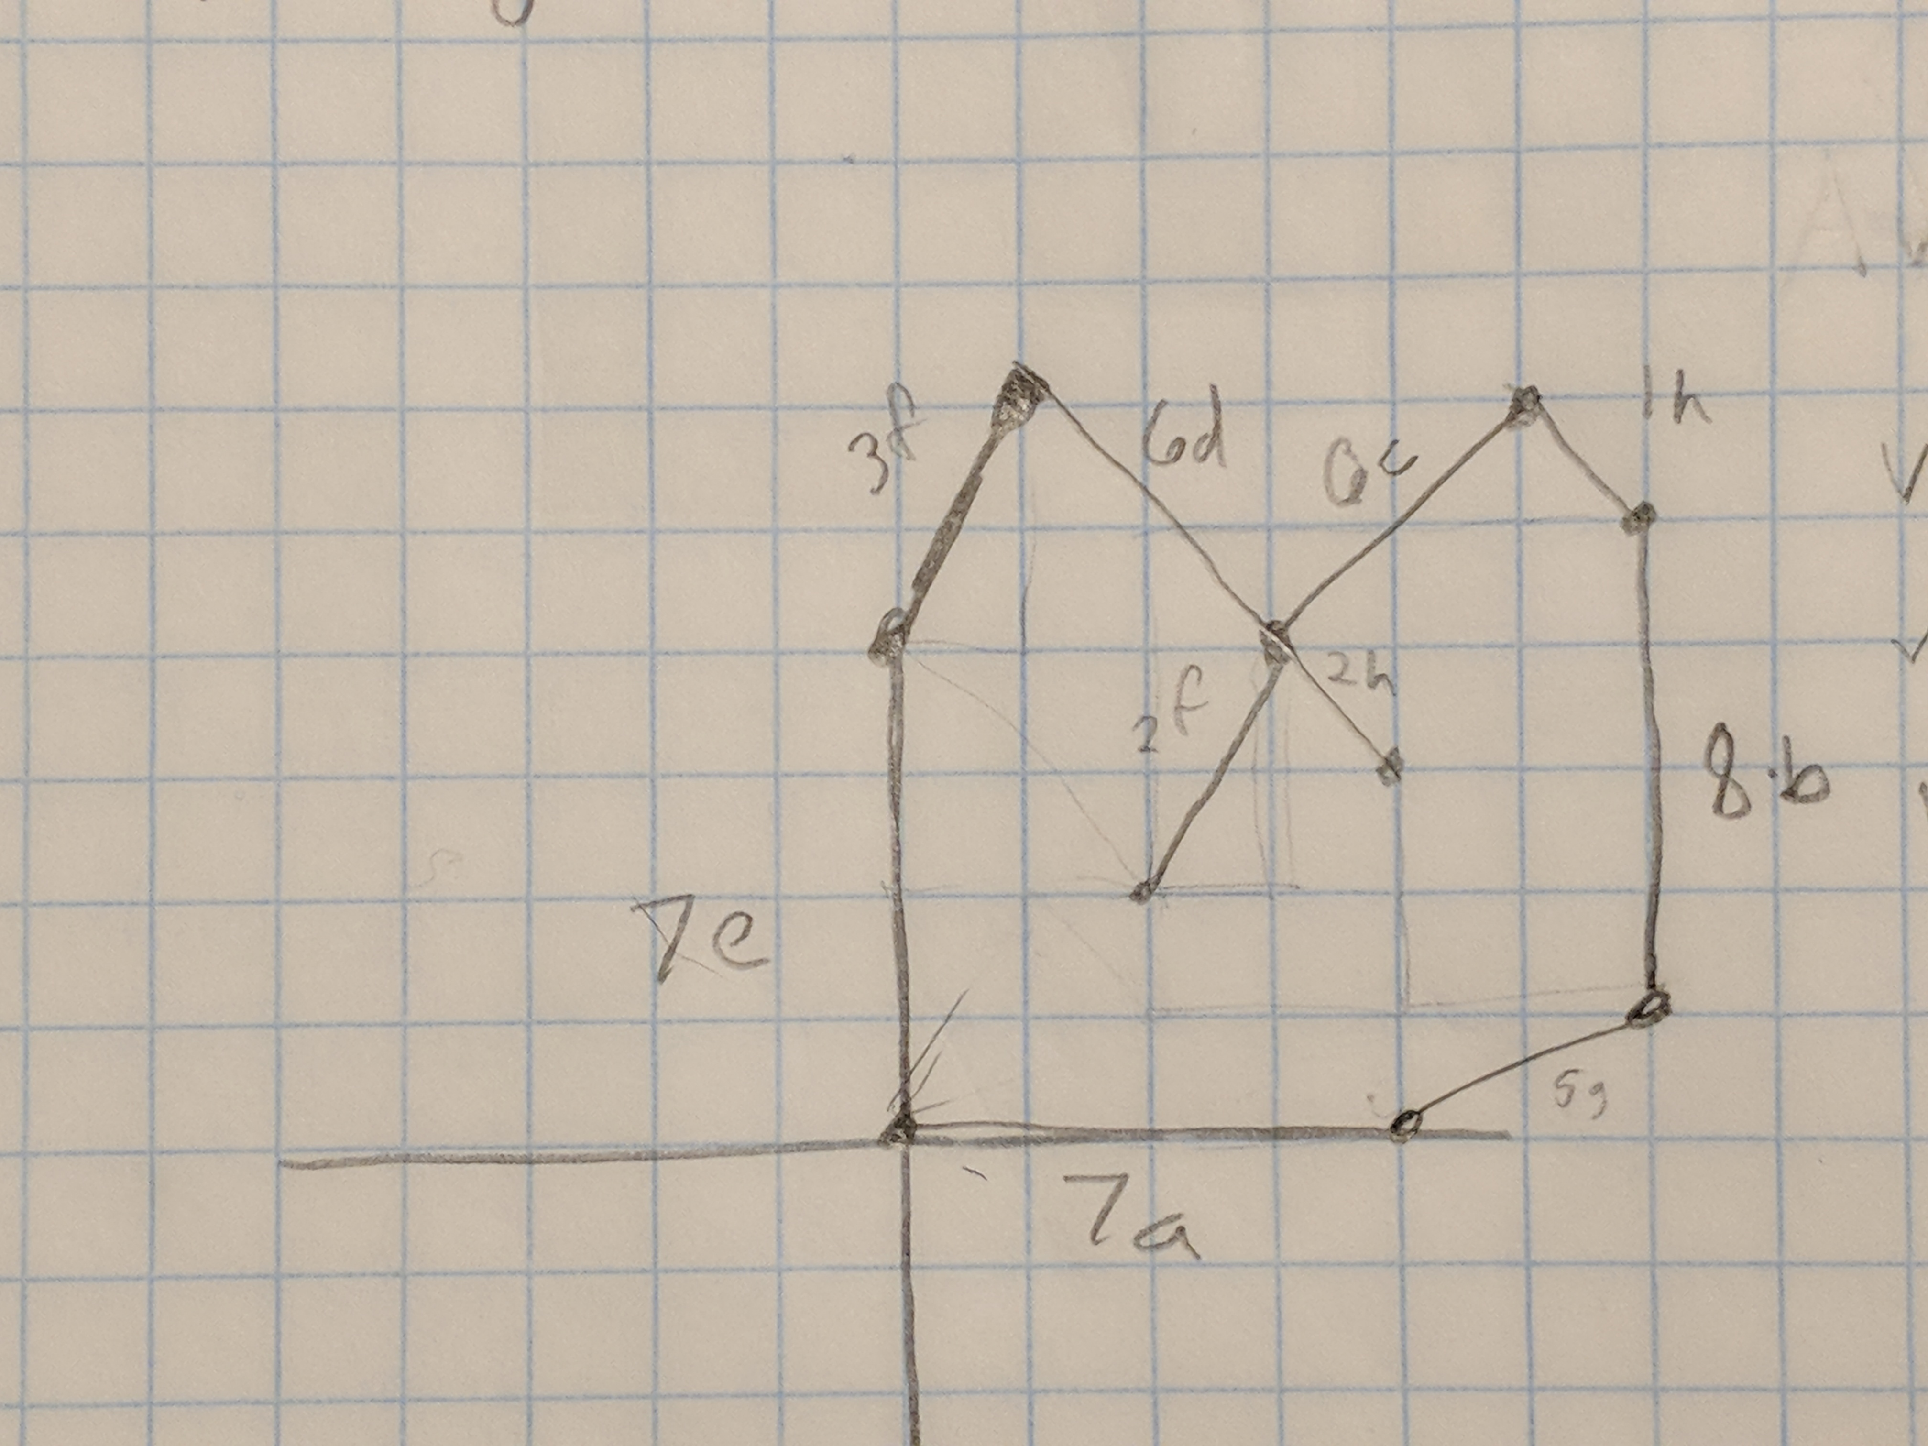
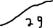
Add the Vertex to Segments within range
Vertex 1: Segment h
Vertex 2: Segment f, Segment h, Segment g
Vertex 3: Segment f
Vertex 4: None
Vertex 5: Segment g
Vertex 6: Segment d, Segment c
Vertex 7: Segment e, Segment a
Vertex 8: Segment b

Slide 11
Problems with Second Approach
What if vertex’s angle from A is equal to a vertex’s angle from B?
Rotate one polygon by epsilon to avoid this problem
What about overlapping lines?

Slide 12
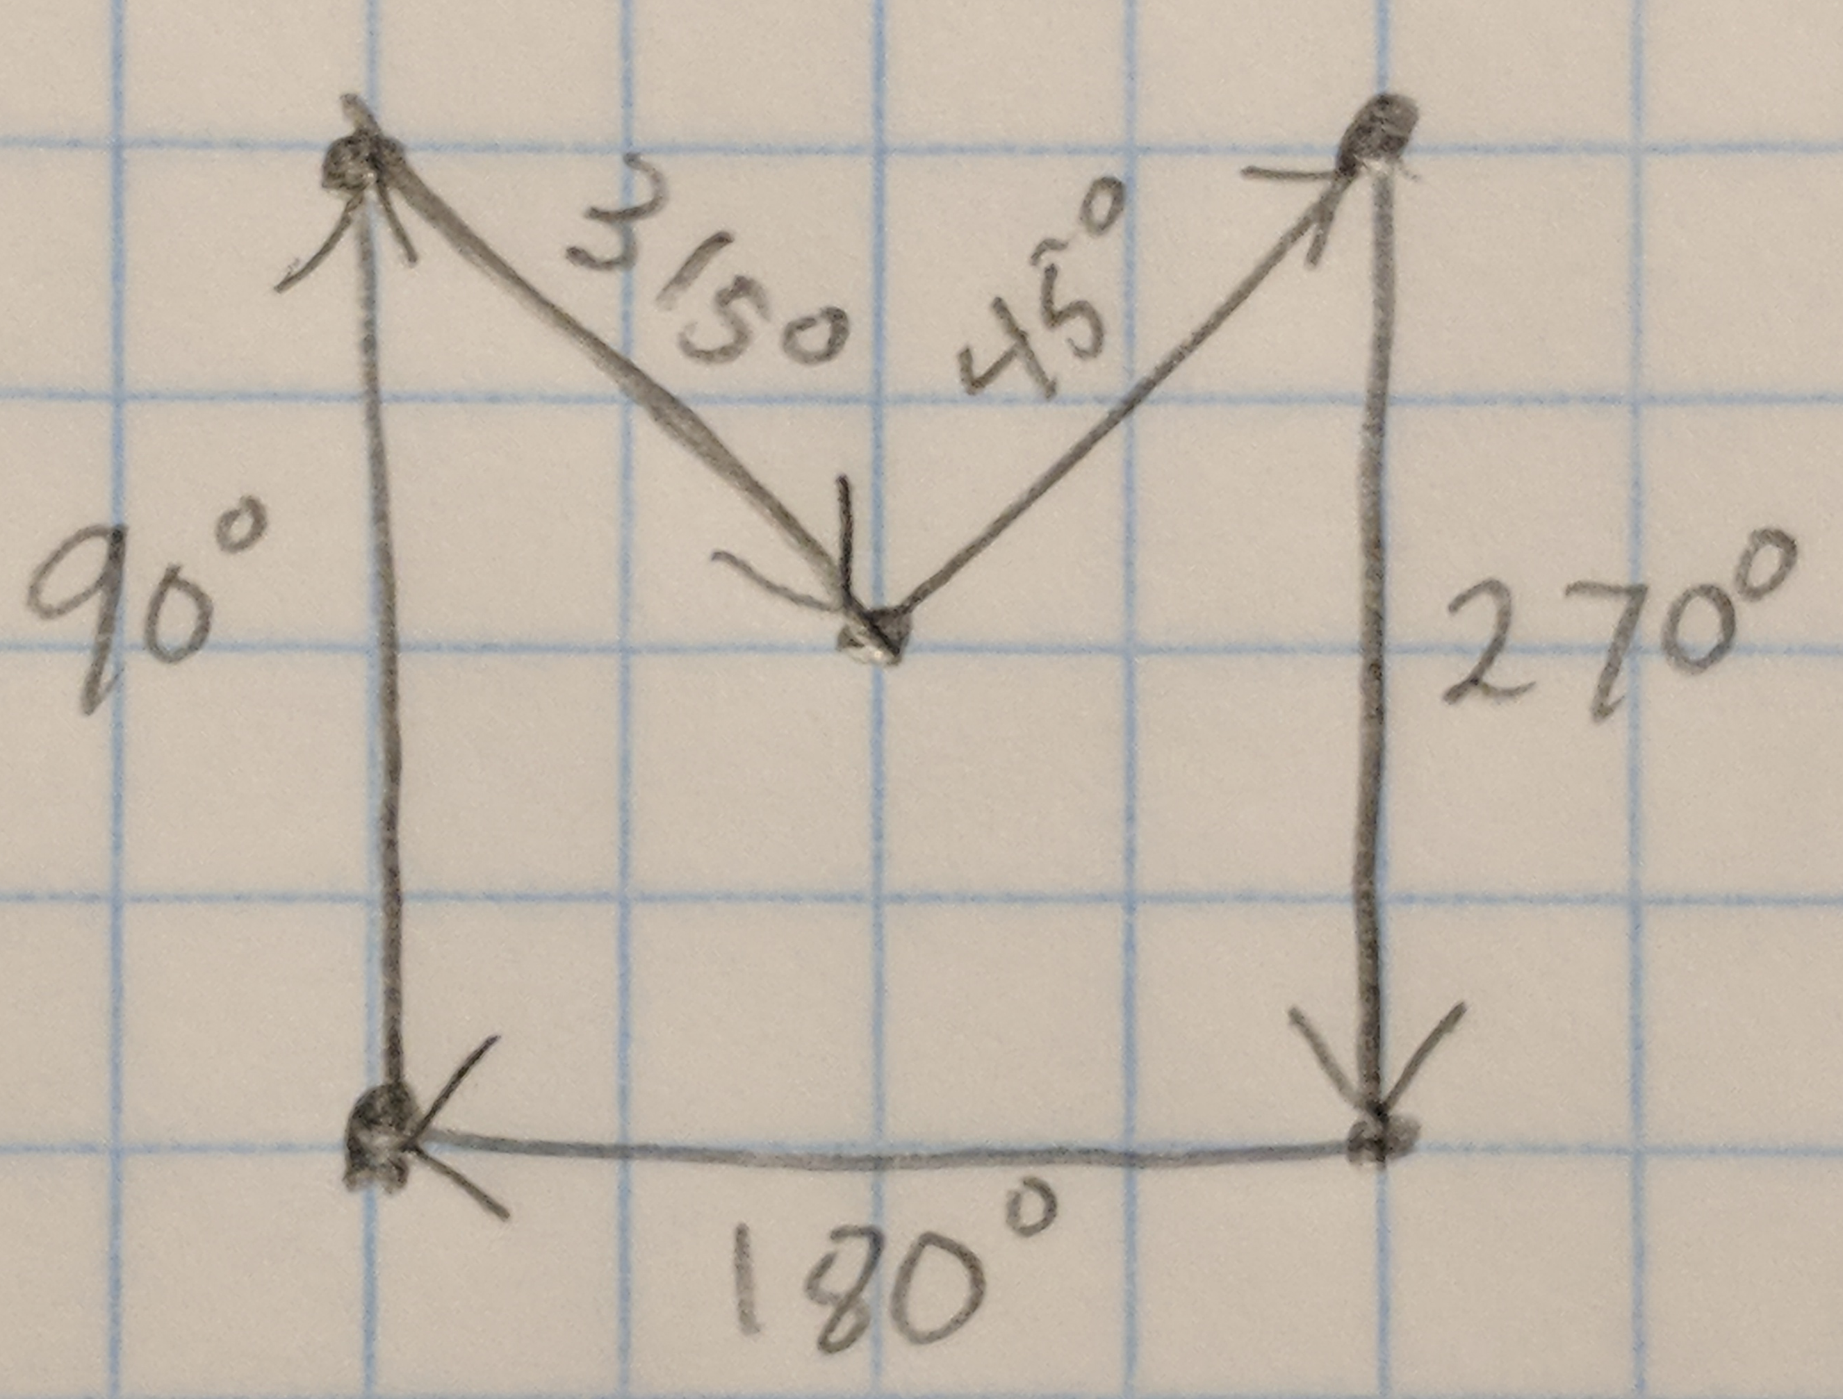

Erosion $(A⊝B)$
Same as Minkowski difference
Erosion is the same as Dilation of Polygon A and Polygon B complement.
Convert the angle calculations from Counter Clockwise to Clockwise

Slide 13
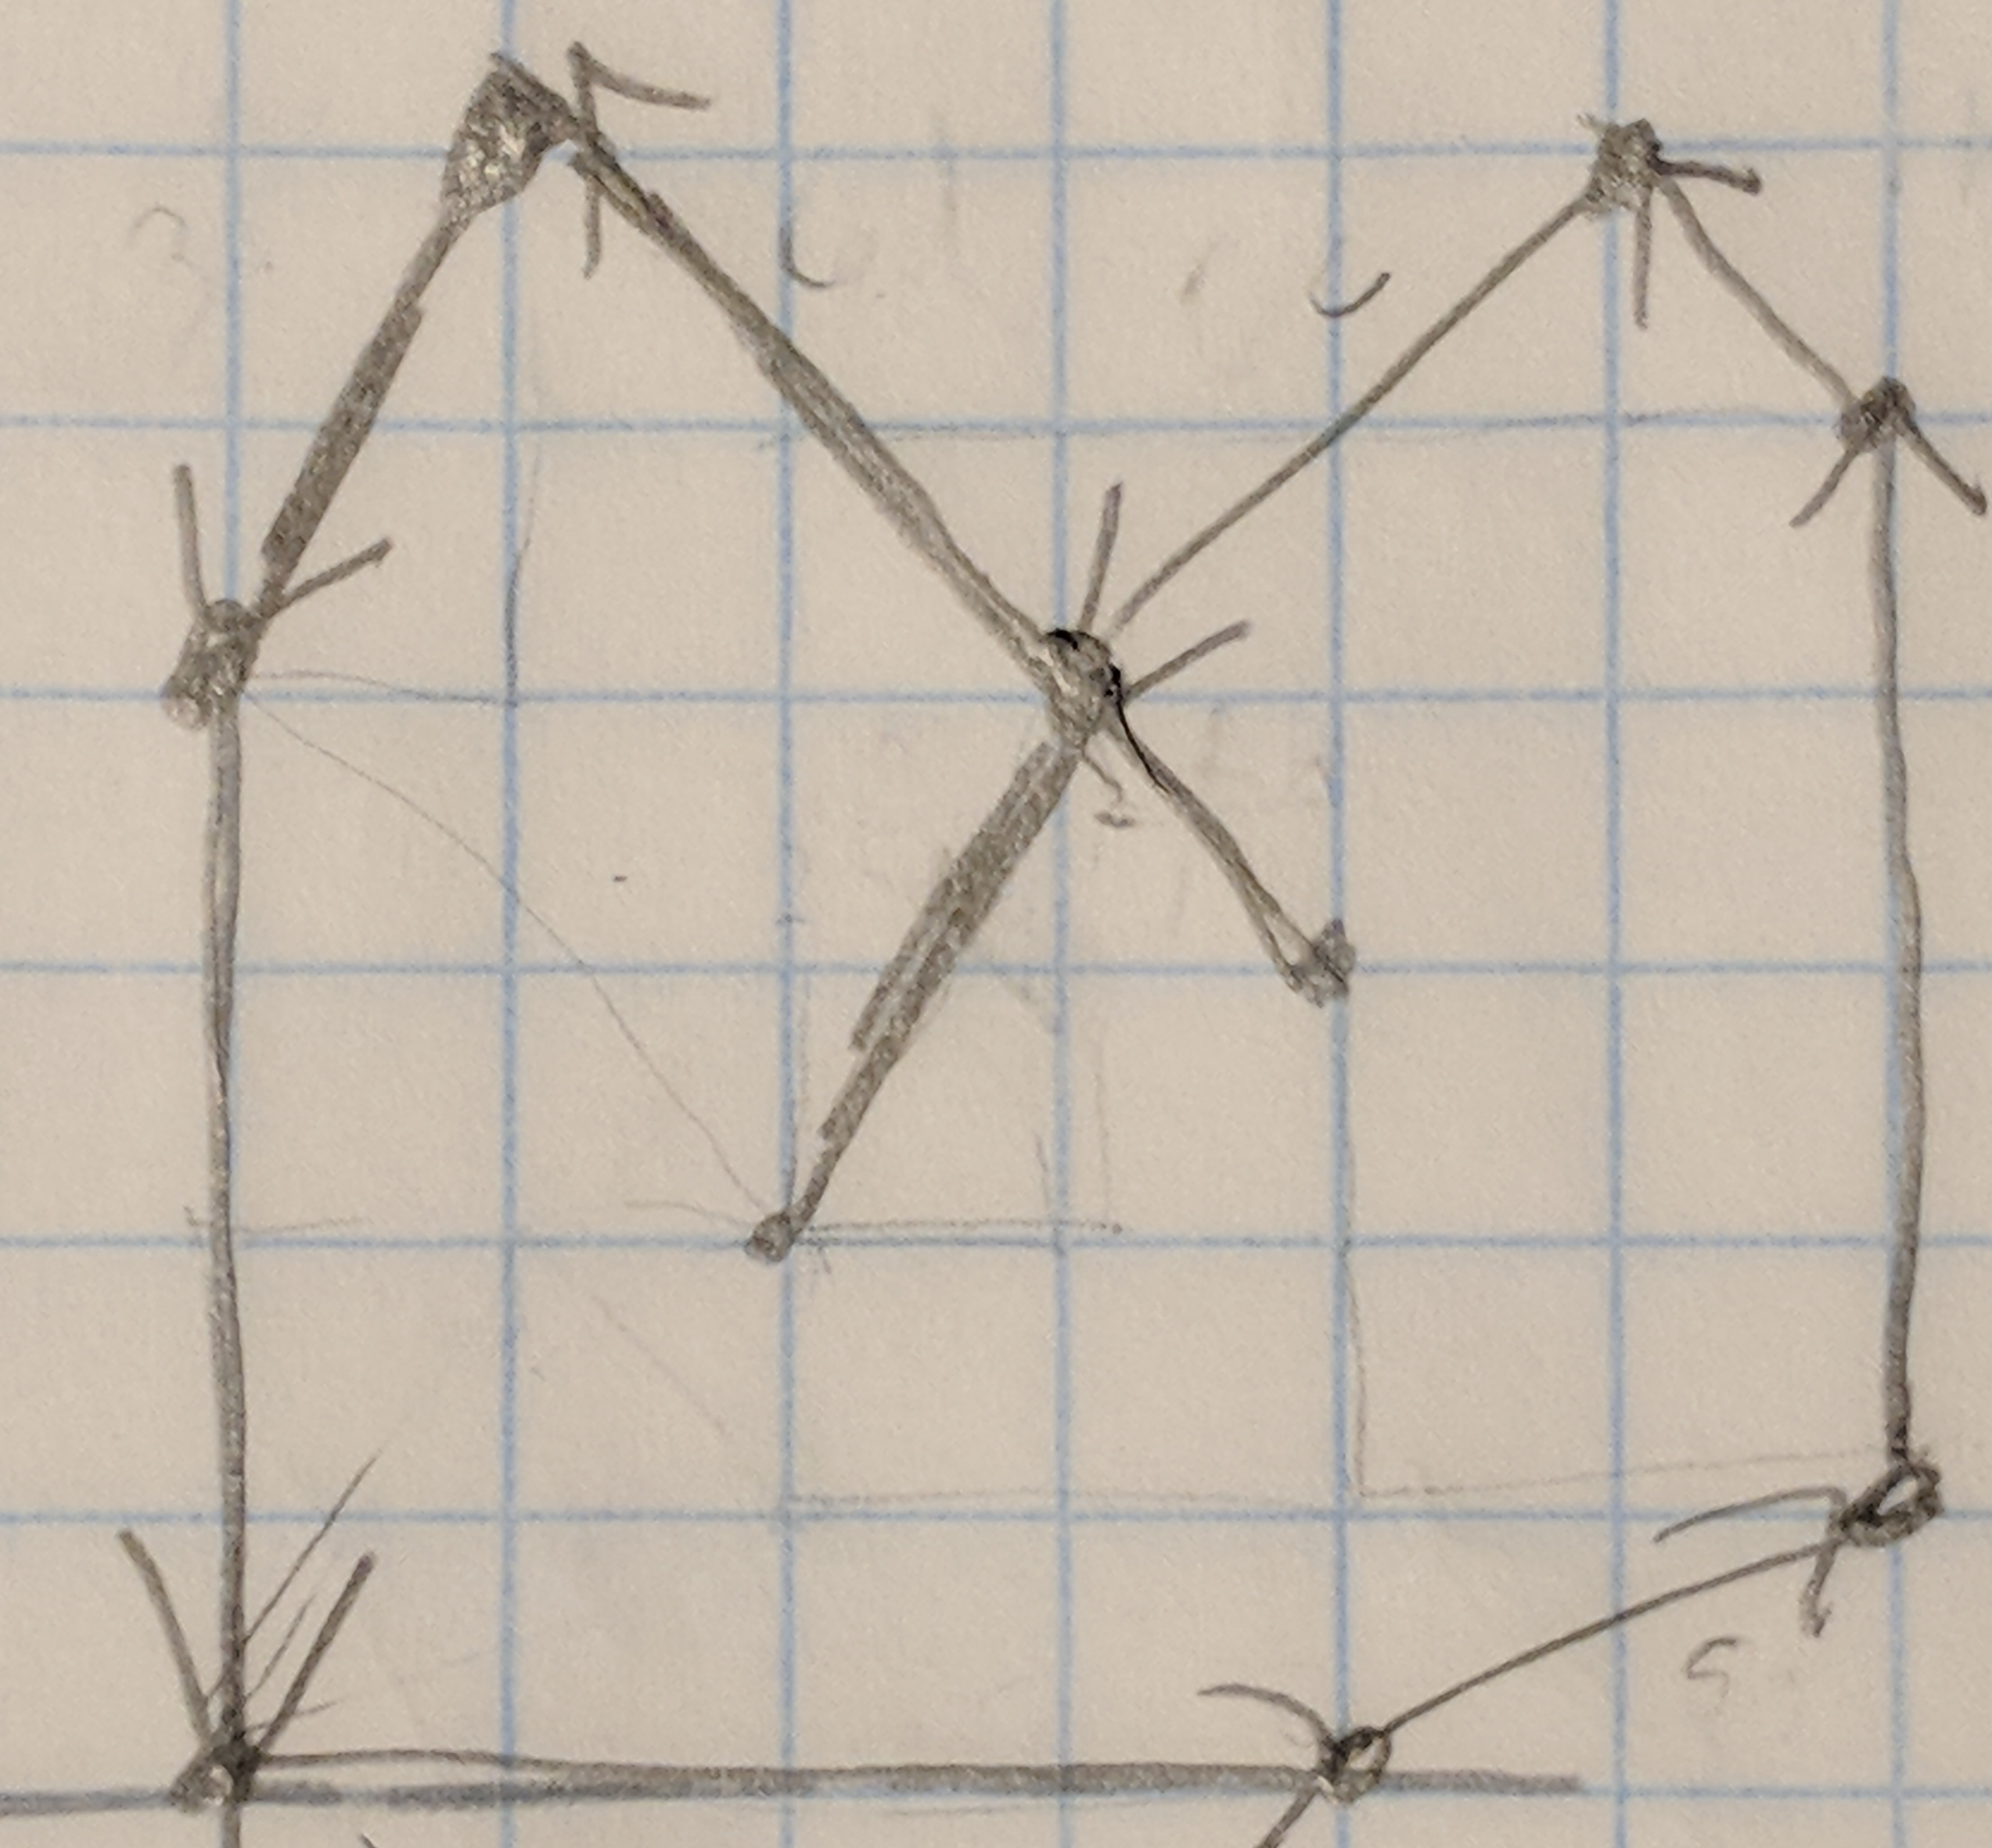

Simplify the Polygon
Compute the Arrangement (break up segments where they intersect)
Choose an extreme edge (leftmost, bottommost, topmost, rightmost)
Traverse the edge counter-clockwise and choose the segment that is connected to it to be part of the final polygon
If there are more than one segment to choose from, choose the rightmost edge

Slide 14
Future Work
How to work with Polygons with Holes?
Simplify Polygon algorithm needs to improve
How to make this work in the 3D space?
Current implementation is in 2D

Slide 15
Demonstration

